Slide 1
Design Patterns
Command Pattern

Slide 2
Command Pattern
The Command Pattern takes encapsulation to a whole new level
An object is used to represent and encapsulate all the information needed to call a method at a later time.

Slide 3
Command Pattern
The Command Pattern is useful for organising and managing tasks
It wraps an action (or set of actions) into a single command object

Slide 4
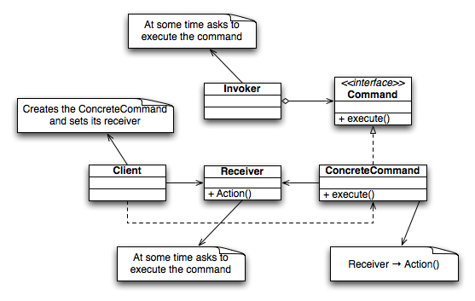
Command Pattern

Slide 5
Command Pattern Uses
Multi level undo
Progress Bars
Wizards
Thread pools
Parallel processing
Anywhere there is a queue of tasks waiting to be executed

Slide 6
Restaurant
We are going to write the code for a restaurant
A restaurant often has a queue of tasks (food orders) waiting to be executed (delivered to the kitchen to be cooked)

Slide 7

Restaurant
This is going to be a very sophisticated restaurant

Slide 8
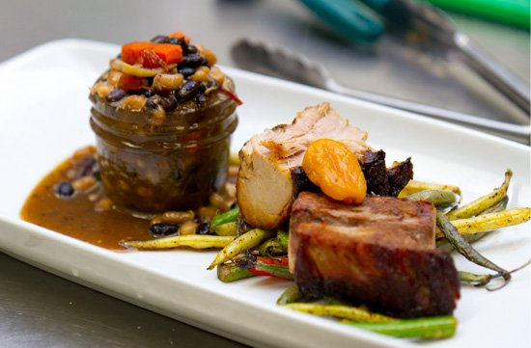
Restaurant
There will be fine food

Slide 9

Restaurant
The waiters and waitresses will be very smart

Slide 10
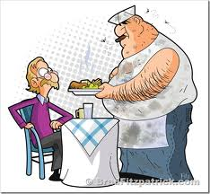
Restaurant
But there is a problem ...
... the chef
He just doesn’t seem to fit in!

Slide 11
Command Pattern
The command pattern allows us ...
...to represent and encapsulate all the information needed to call a method at a later time.
or...
... to create a food order, which can be passed to a waiter/waitress and “executed” (i.e. passed to the chef) at a later time.

Slide 12




Command Pattern

Slide 13
Command Pattern
Demo Time

Slide 14
Patterns
That is the Command Pattern

